Slide 1
AGILE (SCRUM)

Slide 2










What is Agile?
What is
Scrum?
Agile
M anifesto
Agile Principle
Sprint
Scrum Role
Scrum Ceremonies
Scrum Master Services
Scrum
M etrices

Slide 3


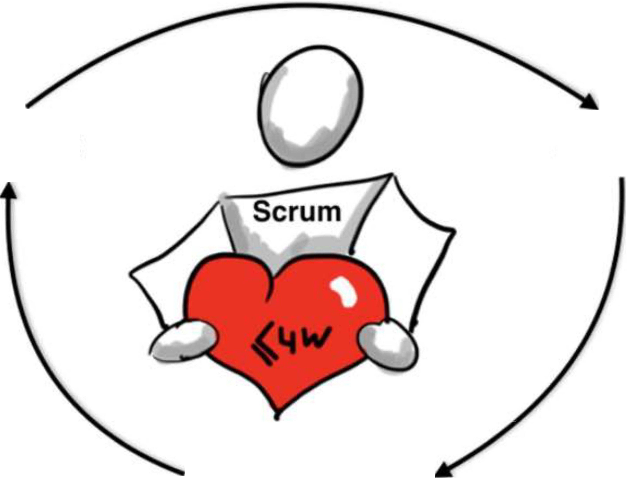
Empirical Process Control
Inspect
Adapt
Transparency

Slide 4
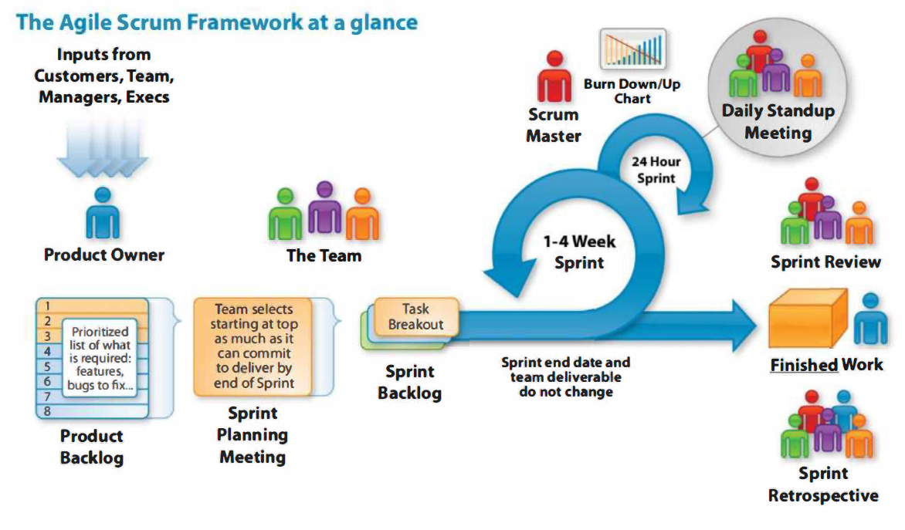

Slide 5
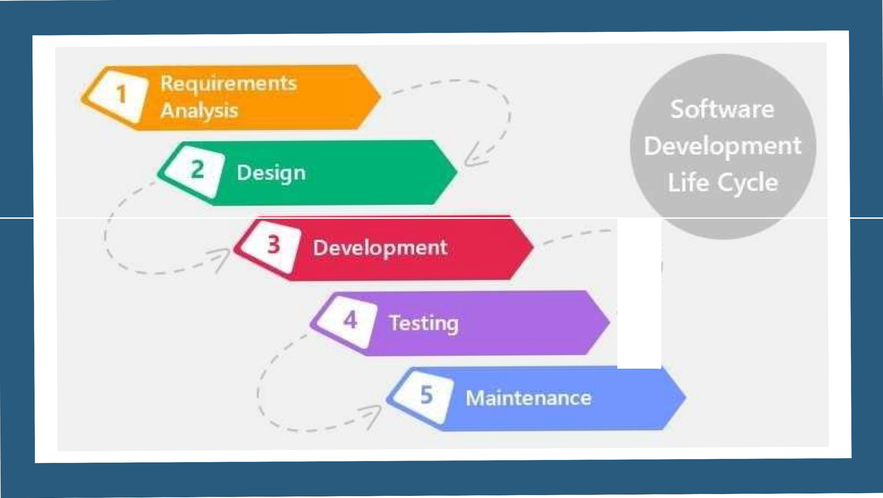
t:_:
I

Slide 6

Agile is an iterative approach to project
management and software development that helps teams deliver value to their customers faster and with fewer headaches. Instead of betting everything on a " big bang" launch, an agile team delivers work in small, but consumable, increments. Requirements, plans, and results are evaluated continuously so teams have a natural mechanism for responding to change quickly.
AGILE

Slide 7
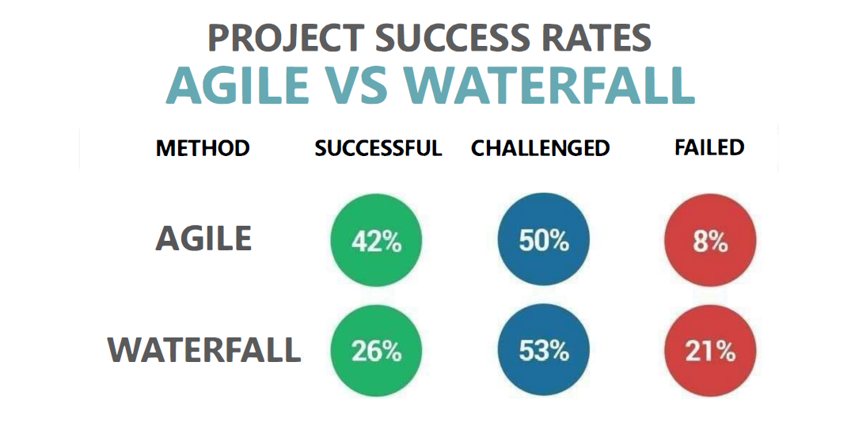

Slide 8
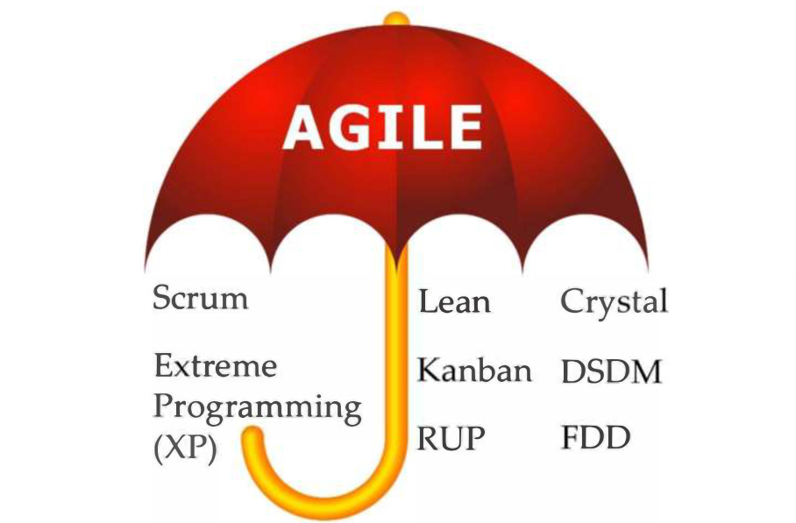

Slide 9
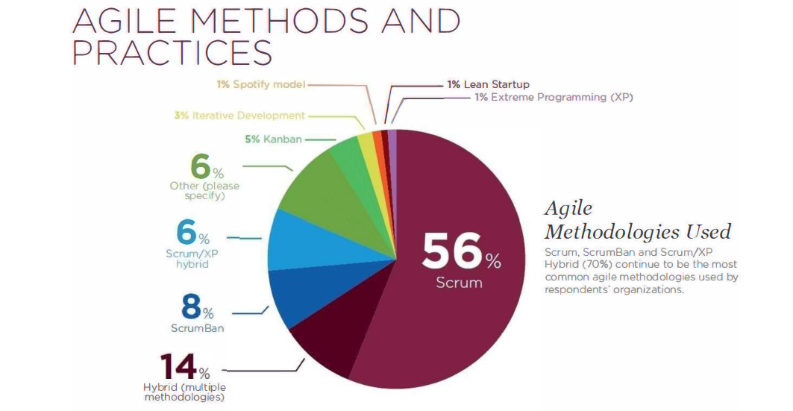

Slide 10
What is scrum?
Definition of Scrum–ScrumFramework
Scrumis a frameworkinwhichthe teamsolves complexproblemsandcomes-up withproductive& innovativesolutions thatareof thehighestpossiblequality.Itis a frameworkthat assists the smooth& productive wayto deliver end products & helps in building agile principles.
Scrum is:
Lightweight
Simple to understand
Difficult to master

Slide 11
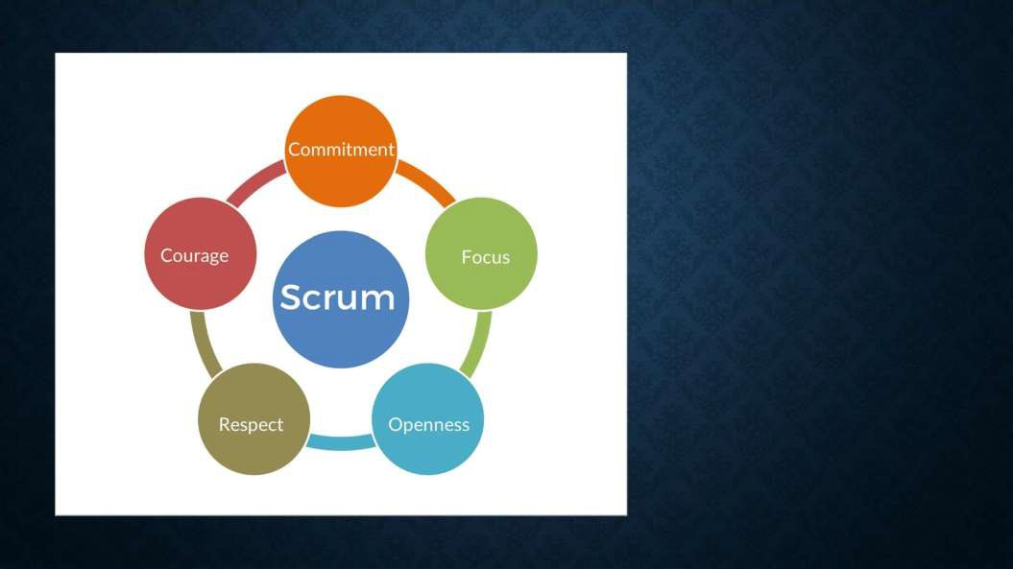
ScrumValues
Commitment–This means dedicationto providing high quality, workingsoftware with active collaboration.
Courage –Meansto accommodate client’s new requirements &to deliver high-quality products every time, in every iteration.
Focus –Means to concentrateon current priorities irrespectiveof their changeability.
Openness –Means transparency in doing workwith stakeholders, consistency withinthe team, openness to accept the new features.
Respect–Means respecting the roles, norms, needs &expectations of variousscrum partners.

Slide 12

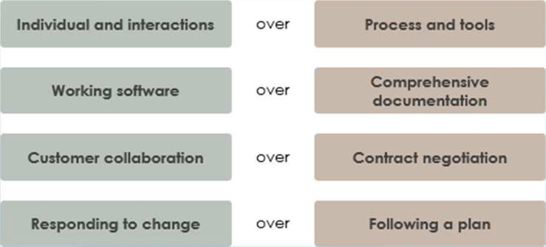
AGILE MANIFESTO

Slide 13
12 Agile principles
Our highest priority is to satisfy the customer through early and continuous delivery of valuable software.
Welcome changing requirements, even late in development. Agile processes harness change for the
customer’s competitive advantage.
Deliver working software frequently, from a couple of weeks to a couple of months, with a preference to the shorter timescale.
Business people and developers must work together daily throughout the project.
Build projects around motivated individuals. Give them the environment and support they need and trust them to get the jobdone.
The most efficient and effective method of conveying information to and within a development team is
face-to-face conversation.

Slide 14
12 Agile principles
Working software is the primary measure of progress.
Agile processes promote sustainable development. The sponsors, developers, and users should be able to maintain a constant pace indefinitely.
Continuous attention to technical excellence and good design enhances agility.
Simplicity — the art of maximizing the amount of work not done — is essential.
The best architectures, requirements, and designs emerge from self-organizing teams.
At regular intervals, the team reflects on how to become more effective, then tunes and adjusts its behavior accordingly.

Slide 15

Scrum Roles
Dev Team
Self Organizing
Cross Functional
Responsible for quality & Design of product
Ideally Co-located & Fully allocated to the project
Ideal team size 6+ 3
Owns and manages Sprint backlog
Participates in all Scrumevents
Estimates items in product backlog Helps product owner in product backlog refinement

Slide 16

Scrum Roles
Product Owner
A person, Not a committee or group
Have product vision
Responsible for success of the project
Owns Product Backlog and does prioritization
Ensure PB is visible, transparent, and clear to all
Ensure Dev Team understand PBI
Available everyday to answer Dev team queries
Strive to maximize the value delivered by Dev team in
every sprint.
Has authority to cancel the sprint
Accepts/Rejects Dev Team work
Represent Business to Dev Team
Represents scrum teamto stakeholders
Make decision on when to release the product
Participates in scrum events as needed.

Slide 17

Scrum Roles
Scrum Master
Servant Leader
Not a manager (Can’t take decision on behalf of PO or Dev
Team)
Focus on People development than on getting result.
Process Owner: Responsible for implementing Scrum Values.
Services to Dev Team
Teaches Scrum values and ensure that the Dev team members understands and adhere to Scrum theory, practices and rules.
Protect from external disturbances
Facilitate scrum events.
Coaches team
Remove Impendent.
Resolve Conflicts

Slide 18

Scrum Roles
Scrum Master
Services to the PO
Teaches Scrum values and ensure that the PO understands and adhere to Scrum theory, practices and rules.
Helps the PO understands how to create and maintain PB efficiently
Helps the PO understands how to prioritize PBI to maximize value.
Coaches PO in writing clear, concise PBI.
Services to the Organization:
Working with other SM to increase the effectiveness of Scrum in organization.
Coaching organization on Scrum
Be a change agent and create environment , culture of Empirical process development

Slide 19
Product Backlog
Orderedand emergent List
Live Document
Different level of details, On top small task, Clear
Final authority withPO
1 Product Backlog, for 1 Product multiple teams

Slide 20


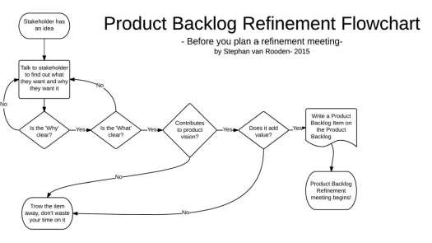
PRODUCT BACKLOG REFINEMENT

Slide 21
Importance of PBR
Increased efficiency
Reduces time for Sprint Planning
Easy to estimate and do the planning
Knowledge sharing among team members

Slide 22
How to make PBR Meeting effective?
Backlog refinement meeting should be considered as the first part of Sprint Planning.
The backlog items’ list should be well understood by the PO, or development team member to work well in the meeting. Make sure that the set of predefined acceptance tests are present.
Keep an eye on the meeting goals.
Make sure to assign action items for any unknown thing.
Do remember that the backlog items are a collaboration between the PO and the team.
Feel free to break the product backlog items during the meeting.

Slide 23
Sprint Backlog
During each sprint planning session, the team returns back to product backlog to pick recently prioritized user stories for the sprint.
Sprint backlog is a subset of product backlog
Sprint backlog is an output of a sprint planning meeting.
In Sprint backlog, scrum team works on how the user stories would be implemented
in a sprint by dividing it further into tasks and estimating it.

Slide 24
Burn Down chart
A burndown chart shows the amount of work that has been completed in an epic or sprint, and the total work remaining. Burndown charts are used to predict your team's likelihood of completing their work in the time available. They're also great for keeping the team aware of any scope creep that occurs.
Burndown charts are useful because they provide insight into how the team works.
For example:
If you notice that the team consistently finishes work early,this might be a sign that they
aren't committing to enough work during sprint planning.
If they consistently miss their forecast, this might be a sign that they've committed to too much work.
If the burndown chart shows a sharp drop during the sprint, this might be a sign that work
has not been estimated accurately or broken down properly.

Slide 25

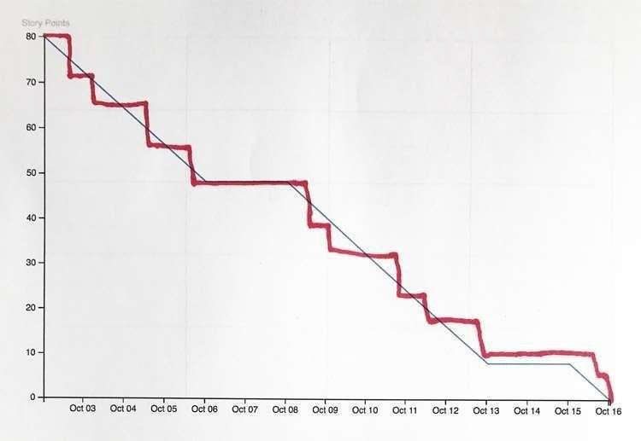
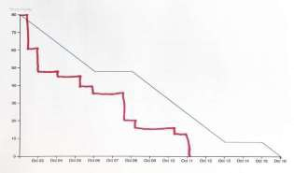
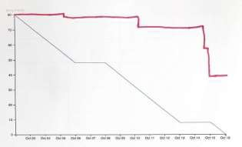
BURN DOWN CHART

Slide 26
Scrum Events
Sprint Planning Meeting
Sprint Retrospective
Daily Scrum
Sprint Review

Slide 27
Sprint planning meeting
The work to be performed in the Sprint is planned at the Sprint Planning. This plan is
created by the collaborative work of the entire ScrumTeam.
Sprint Planning is time-boxed to a maximum of eight hours for a one-monthSprint. For shorter Sprints, the event is usually shorter. The Scrum Master ensures that the event takes place and that attendants understand its purpose.
Sprint Planning answers the following:
What can be delivered in the Increment resulting from the upcoming Sprint?
How will the work needed to deliver the Increment be achieved?

Slide 28
Daily Scrum
15-minute time-boxed event for the DevelopmentTeam
Everyday
Same time and place each day to reduce complexity
Inspect progress toward the Sprint Goal
Meeting Structure:
What I did yesterday ?
What will I do today ?
Do I see any impediment that prevents me

Slide 29
Daily Scrum
The Development Team or team members often meet immediately after the Daily Scrum for detailed discussions, or to adapt, or re-plan, the rest of the Sprint’swork.
The Scrum Master ensures that the Development Team has the meeting, but the Development Team is responsible for conducting the Daily Scrum. The Scrum Master teaches the Development Team to keep the Daily Scrum within the 15-minute time-box.
The Daily Scrum is an internal meeting for the Development Team. If others are present, the
Scrum Master ensures that they do not disrupt themeeting.
Daily Scrums improve communications, eliminate other meetings, identify impediments to development for removal, highlight and promote quick decision-making, and improve the Development Team’s level of knowledge. This is a key inspect and adapt meeting.

Slide 30
Sprint review
At most a four-hour meeting for one-month Sprints
Attendees include the Scrum Team and key stakeholders invited by the ProductOwner;
The Development Team demonstrates the work that it has "Done" and answers questions about the Increment;
The ProductOwner discusses the Product Backlog as it stands. He or she projects likely target and delivery dates based on progress to date (ifneeded);
The entire group collaborates on what to do next, so that the Sprint Review provides valuable input to subsequent Sprint Planning;
Review of how the marketplace or potential use of the product might have changed what
is the most valuable thing to do next; and,

Slide 31
Sprint retrospective
The Sprint Retrospective is an opportunity for the Scrum Team to inspect itself and
create a plan for improvements to be enacted during the next Sprint.
The Sprint Retrospective occurs after the Sprint Review and priorto the next Sprint Planning
The purpose of the Sprint Retrospective is to:
Inspect how the last Sprint went with regards to people, relationships, process, and tools;
Identify and order the major items that went well and potential improvements; and,
Create a plan for implementing improvements to the way the Scrum Team does its work.

